Slide 1



PYTHON
PROGRAMMING

Slide 2

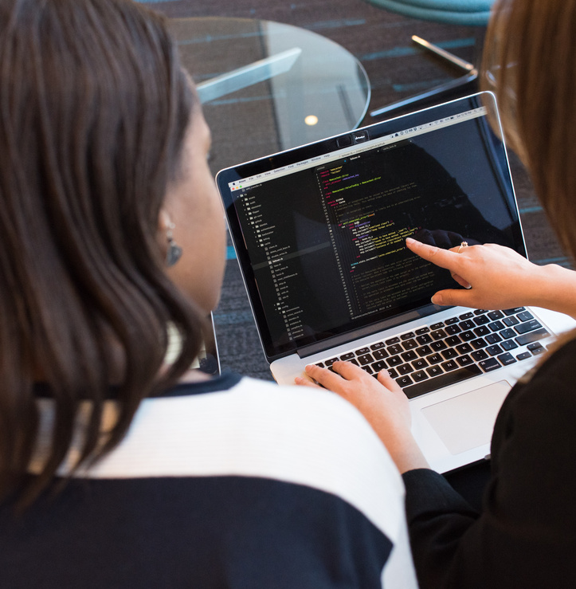


TOPICS:
1. Functions and modules.
2. Data manipulation.

Slide 3
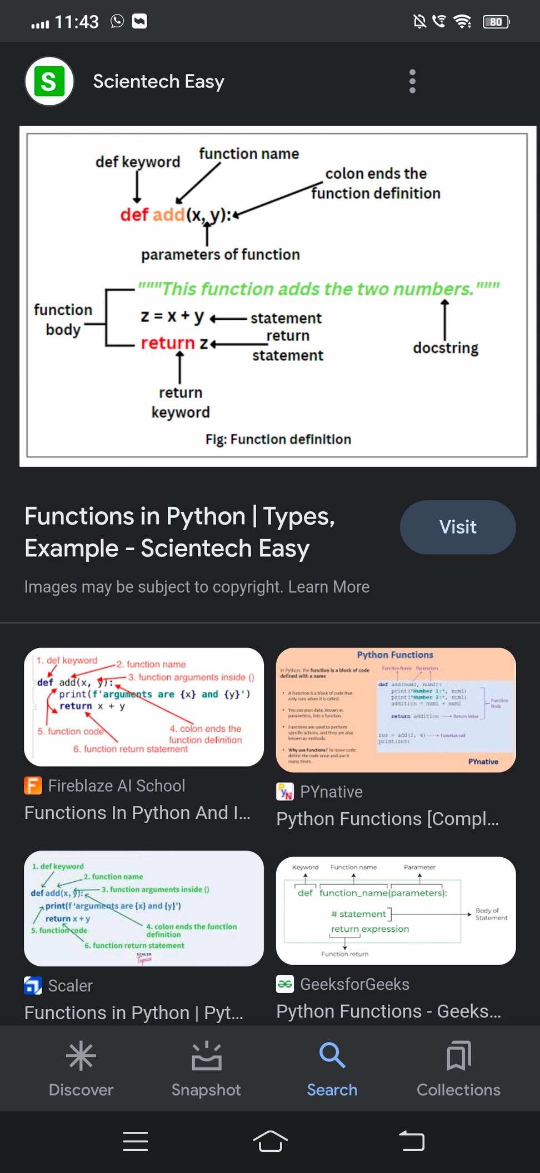
FUNCTION
A function is a block of code which only runs when it is called.
You can pass data, known as parameters, into a function.
A function can return data as a result.
Some of the key benefits of using functions are:
Enables reusability and reduces redundancy.
Makes a code modular.
Provides abstraction functionality.
The program becomes easy to understand and manage.

Slide 4
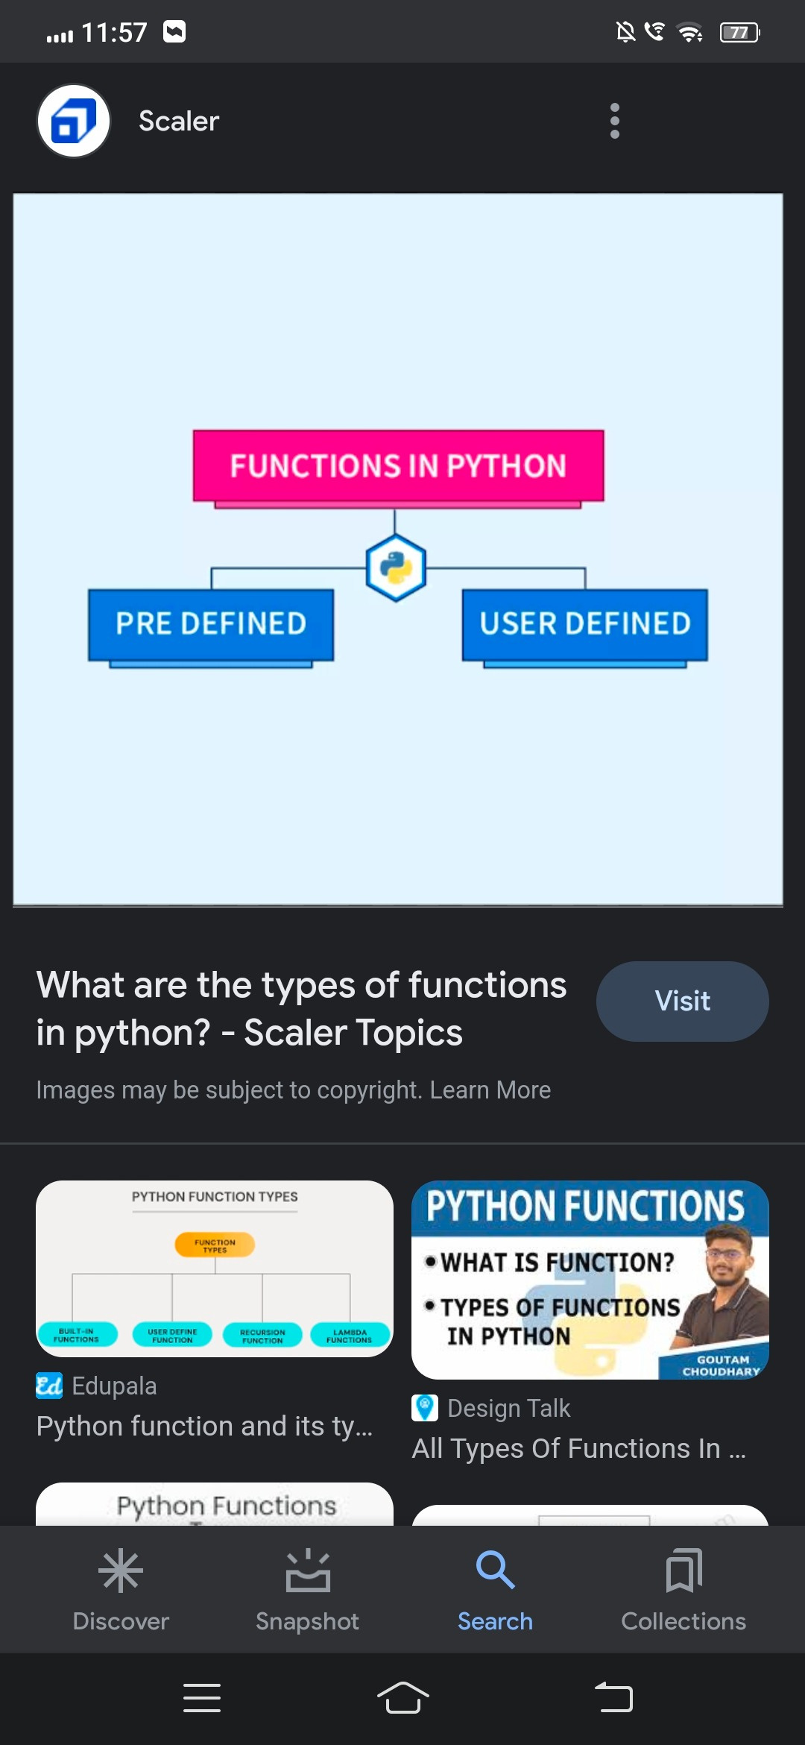
TYPES OF FUNCTIONS
There are mainly two types of functions in Python
1. Built-in library function: These are Standard functions in Python that are available to use.
2. User-defined function: We can create our own functions based on our requirements

Slide 5
CALLING A PYTHON FUNCTION
To call a function in Python, you simply type the name of the function followed by parentheses (). If the function takes any arguments, they are included within the parentheses.

Slide 6

WHAT ARE MODULES IN PYTHON?
A Python module is a file containing Python definitions and statements. A module can define functions, classes, and variables. A module can also include runnable code. Grouping related code into a module makes the code easier to understand and use. It also makes the code logically organized.

Slide 7
Create a Module:
To create a module just save the code you want in a file with the file extension .py:
Example:
Save this code in a file named mymodule.py
def greeting(name):
print("Hello, " + name)
Use a Module:
Now we can use the module we just created, by using the import statement:
Example:
Import the module named mymodule, and call the greeting function:
import mymodule
mymodule.greeting("Jonathan")

Slide 8


DATA MANIPULATION
Data manipulation with python is defined as a process in the python programming language that enables users in data organization in order to make reading or interpreting the insights from the data more structured and comprises of having better design.

Slide 9
DATA MANIPULATION METHODS
Python has been the most famous and most used language amongst developers in order to manipulate data in a dataset. With open-source implementations in Python, we have various methods that help in the implementation of the manipulation methods in Python. For all the following methods we would first need to install pandas in python and that can be achieved by running the following command in the command prompt, pip install pandas.
Once the pandas package is installed in the system, we would need to import the pandas library into our codebase by running

Slide 10
DATA MANIPULATION METHODS
import pandas as pd
The reason one would use pd is to make sure that we can use the short form wherever we would need to call the corresponding package. Now that we have installed and imported the pandas library, we would use one of its functions to read the CSV file and then store the return dataset into a variable. we would run the following code:
variable_name = pd.read_csv("file name.csv")

Slide 11

THANK YOU

